Slide 1
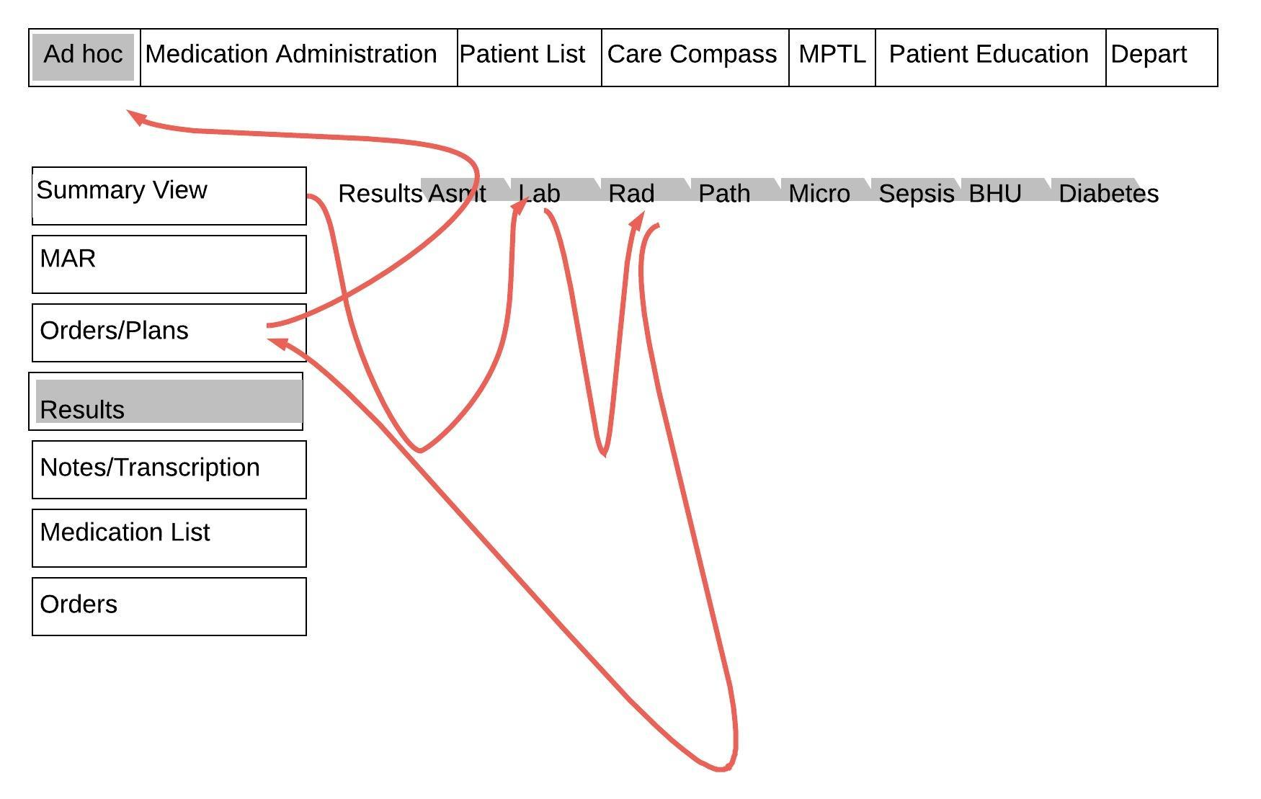
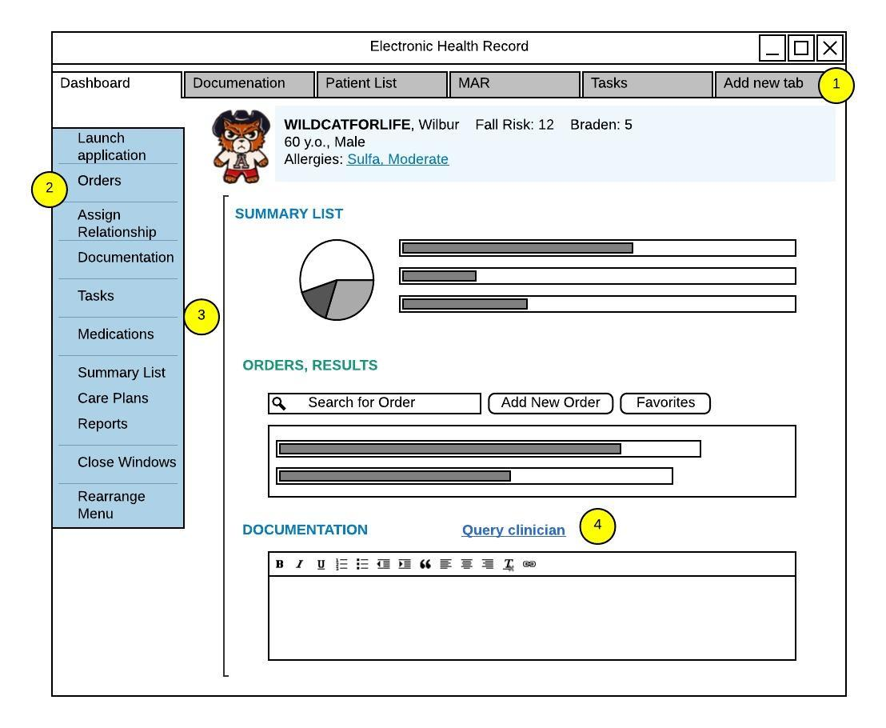
Mining Information in EHR Logs: An Alternative Data Source for EHR Workflow Analysis
D Anthony Tolentino, MA, RN-BC, PhD Candidate; Sheila M. Gephart, PhD, RN, FAAN; Vignesh Subbian, PhD
Purpose/Aims
Results
Table 2: 9-Step Markov chain model: Probability of EHR events transitioning over multiple steps
Characterize nurses’ Electronic Health Record (EHR) navigational behaviors by identifying recurring patterns using audit logs
Predict nurses’ navigational patterns to optimize EHR screen designs
Table 1: Sample characteristics (N = 20)
User characteristics (Table 1)
Audit logs produced 641 unique patient encounters, 99, 171 data rows, and 41, 324 open charts between April to June 2019
Documentation: most frequently used EHR feature (28.35% of nurses’ time)
Care plans and reports: least frequently used EHR features (<2%)
Characteristics | n (%) | M(SD)
Age |  | 49.94(11.55)
51-65 years old | 14 (70)
23-38 years old | 4 (20)
Years of practice |  | 18.42(11.89)
6-15 years | 9(45)
16-30 years | 8(40)
Computer proficiency |  | 7.00(1.65)
EHR proficiency |  | 7.25 (1.97)
Gender: Female | 20(100)
Ethnicity
White | 14(70)
Asian | 4(20)
Education
Bachelors | 14(70)
Associates/Masters | 6(30)
Practice setting
Medical/Surgical | 7(35)
Critical Care | 4(20)
Perinatal | 3(15)
Step-down/Tele | 3(15)
 | IS | Step 1 | Step 2 | Step 3 | Step 4 | Step 5 | Step 6 | Step 7 | Step 8 | Step 9
A | 0 | 0.0000 | 0.0261 | 0.0042 | 0.0064 | 0.0036 | 0.0038 | 0.0035 | 0.0035 | 0.0035
B | 1 | 0.0444 | 0.1118 | 0.0193 | 0.0284 | 0.0165 | 0.0175 | 0.0159 | 0.0160 | 0.0158
C | 0 | 0.1244 | 0.1412 | 0.1577 | 0.1540 | 0.1493 | 0.1442 | 0.1408 | 0.1384 | 0.1370
D | 0 | 0.0000 | 0.0044 | 0.0127 | 0.0141 | 0.0144 | 0.0137 | 0.0131 | 0.0125 | 0.0121
E | 0 | 0.0022 | 0.0065 | 0.0220 | 0.0346 | 0.0441 | 0.0501 | 0.0539 | 0.0562 | 0.0576
F: Launch | 0 | 0.5089 | 0.0343 | 0.0930 | 0.0314 | 0.0373 | 0.0290 | 0.0294 | 0.0282 | 0.0282
H: Document | 0 | 0.0011 | 0.0440 | 0.1153 | 0.1746 | 0.2163 | 0.2429 | 0.2594 | 0.2692 | 0.2751
I | 0 | 0.0033 | 0.0393 | 0.0679 | 0.0816 | 0.0895 | 0.0934 | 0.0957 | 0.0969 | 0.0976
J | 0 | 0.0011 | 0.0490 | 0.0693 | 0.0733 | 0.0736 | 0.0728 | 0.0721 | 0.0717 | 0.0714
K: Summary | 0 | 0.3022 | 0.3404 | 0.2934 | 0.2549 | 0.2247 | 0.2056 | 0.1933 | 0.1859 | 0.1815
L | 0 | 0.0000 | 0.1582 | 0.0822 | 0.0765 | 0.0575 | 0.0528 | 0.0487 | 0.0472 | 0.0463
P | 0 | 0.0000 | 0.0019 | 0.0058 | 0.0074 | 0.0084 | 0.0087 | 0.0088 | 0.0087 | 0.0086
Q | 0 | 0.0122 | 0.0427 | 0.0573 | 0.0627 | 0.0648 | 0.0654 | 0.0655 | 0.0655 | 0.0654
Background
Note: Letters correspond to the different EHR events (see transition graph for complete legend)
Implications and Conclusion
EHR logs can be used as an alternative data source for EHR workflow analysis
Empirical data from EHR logs can be used as a source for EHR screen redesign
Investigating the impact of nurses’ interaction with the EHR in a complex sociotechnical environment can often be challenging as several gaps exist in examining nurses’ workflow
Transition probability matrix: probability distribution of EHR event transitions
Method
Computational Ethnography from unobtrusive data sources (e.g. EHR audit logs) guided by Task-Technology Fit Theory¹
Random sampling of 20 participants from 95 participants who completed a related study in a multisite healthcare facility (three acute care hospitals)
Data analysis involved Markov chain analysis (MCA) using R software, producing a Transition probability matrix (TPM) and a 9-Step Markov chain model to identify EHR navigation
MCA is a stochastic process that shows transition from one Markov state to another (i.e. Markov state = EHR events within the audit log)²
Figure 2: Redesigning an EHR screen based on TPM/MCA results.
References and copy of the poster
Figure 1: Transition Probability Matrix Graph
Note: Only the top 2 dominant probabilities for each event are depicted in the diagrams. The size of the sequence nodes denotes the overall frequency of use. The bold red arcs reflect the highest probability for that event. The black arcs denote the second-highest probability for that event.
Acknowledgement: Mr. Tolentino received support from the Frederick Lange Memorial Endowment for this dissertation research.
Contact Information: @an2ny antolentino@email.arizona.edu

